Slide 1

Red Wine Predictor
March 16th 2018
Ananth Muniyappa

Slide 2
Pain Point
Consumers (non-sommeliers) are not well informed about the characteristics of a high quality red wine, i.e., they don’t know the how to select good red wine!
This barrier to selection occurs at restaurants, wines stores and bars; essentially vendors supplying red wine
The multiple characteristics of high quality wine (e.g., sulphur content, citric acid content, ph level etc.) are often times over whelming considerations for a regular consumer during the selection process

Slide 3
Key Contributing Factors to Personalized Red Wine Selection
fixed acidity
volatile acidity
citric acid
residual sugar
chlorides
free sulfur dioxide
total sulfur dioxide
density
pH
sulphates
alcohol quality

Slide 4

Data Set Analysis
Upon analyzing data within the Python Notebook one can determine statistically significant predictors vs. insignificant predictors.
Based on this analysis one can determine the optimum prediction model for the desired output

Slide 5
Optimum Prediction Model
#Logistic Regression
#Decision Tree
#Naive Bayes
#Random Forest
#SVC

Slide 6
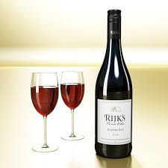
Next Steps
Get a BROADER data set and….
…..Go drink GOOD Red Wine!!

